Slide 1

Domain Name System
The Internet’s Phone Book

Slide 2

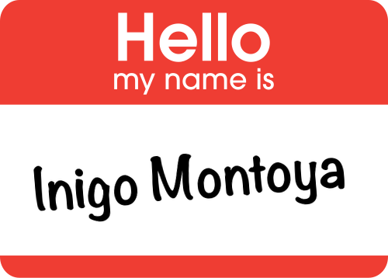
name resolution
Notes:
turn www.digipen.edu into 107.6.89.11
Has to be a central authority that provides a mapping between human-readable names and IP addresses. This being the Internet, that “central” authority is distributed.

Slide 3
One IP to multiple hostnames
(Virtual Hosting)
No 1:1 Mapping!
Multiple IPS to one HOSTNAME
(Load balancing)
Notes:
one ip can serve multiple hostnames (virtual hosting)
one hostname can have multiple ip addresses (fault tolerance and load balancing)

Slide 4
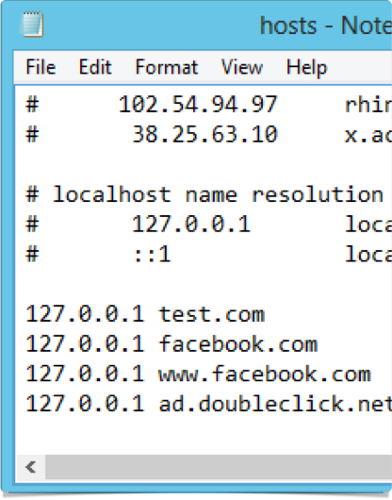
hosts file
Local Lookups
Notes:
original solution
doesn’t scale well
useful as a simple tool for controlling your own DNS
dangerous as an easy way for hackers to control your own DNS
On Windows it’s C:\Windows\System32\Drivers\etc\hosts
Everywhere else it’s /etc/hosts

Slide 5

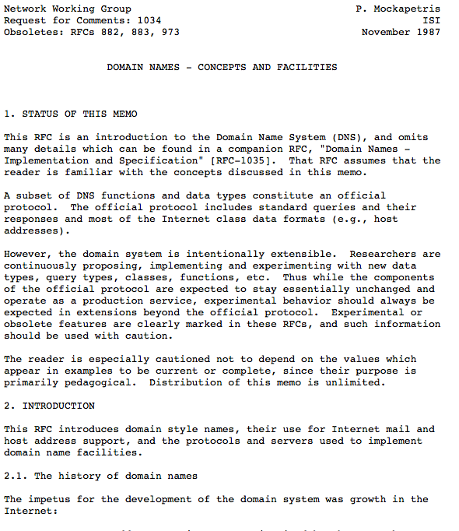
DNS
RFC1034 & RFC1035
Notes:
giant distributed database, used for stuff other than DNS

Slide 6

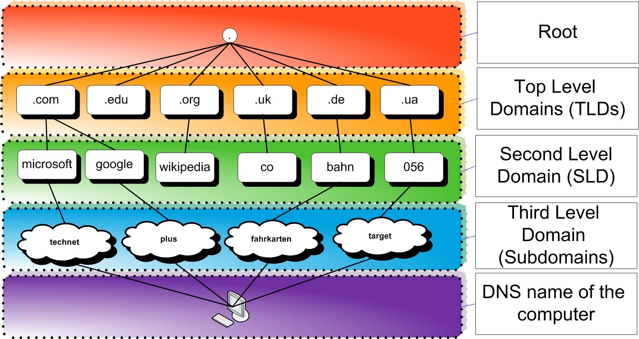
www.digipen.edu.
www.digipen.edu.
www.digipen.edu.
www.digipen.edu.
www.digipen.edu.
Notes:
responsibility of each subdomain to ensure uniqueness
some effectively-subdomains aren’t represented in the name. individual registrars are like this.

Slide 7


DNS Resolution
distance.digipen.edu
Notes:
maintains database of mappings
can talk to other dns servers to look up names it doesn’t know
if it gets an answer, it caches that answer for a period of time (“time to live”), but marks its answer as being possibly incorrect (“non-authoritative”)

Slide 8




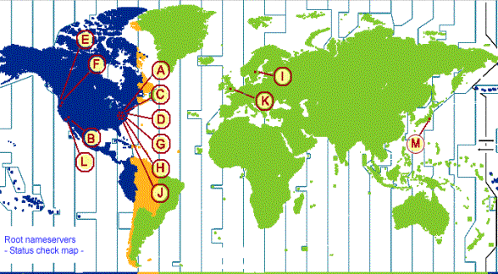
DNS Resolution
Hey root: .edu?

Slide 9

DNS Resolution
.edu is 192.5.6.30

Slide 10


DNS Resolution
Hey edu: .digipen?
.digipen is 204.174.42.68

Slide 11


DNS Resolution
Hey digipen: distance?
distance is 204.174.42.106 …for the next hour

Slide 12




DNS Resolution
distance.digipen.edu is 204.174.42.106 for 1 hour
distance.digipen.edu is 204.174.42.106

Slide 13

DNS Resolution
distance.digipen.edu is 204.174.42.106 for 1 hour
distance.digipen.edu is 204.174.42.106
distance.digipen.edu?

Slide 14

Not just names
A: Name to IP address
CNAME: Name to another name
MX: Mail servers for a domain
SOA: “Start of Authority”
TXT: “Here’s some random data”
…and many more at http://en.wikipedia.org/wiki/List_of_DNS_record_types
Notes:
A: Name to IP address
CNAME: Name to another name
MX: Mail servers for a domain
SOA: “Start of Authority”
TXT: “Here’s some random data”
…and many more at http://en.wikipedia.org/wiki/List_of_DNS_record_types

Slide 15
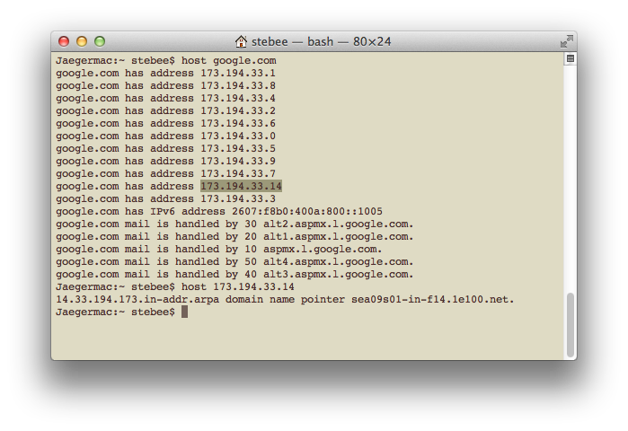
Reverse Lookup
in-addr.arpa.106.42.174.204

Slide 16
gethostbyname()
gethostbyaddr()
Notes:
http://beej.us/guide/bgnet/output/html/multipage/syscalls.html#getaddrinfo

Slide 17
Creating addresses with getaddrinfo()
sockaddr_in* CreateAddress(char* ip, int port)
{
sockaddr_in* result = (sockaddr_in*)calloc(sizeof(*result), 1);
result->sin_family = AF_INET;
result->sin_port = htons(port);
if (ip == NULL)
result->sin_addr.S_un.S_addr = INADDR_ANY;
else
result->sin_addr.S_un.S_addr = inet_addr(ip);
return result;
// Caller will be responsible for free()
}

Slide 18
Creating addresses with getaddrinfo()
if (ip == NULL)
result->sin_addr.S_un.S_addr = INADDR_ANY;
else
result->sin_addr.S_un.S_addr = inet_addr(ip);
return result;
// Caller will be responsible for free()
}

Slide 19
Creating addresses with getaddrinfo()
if (ip == NULL)
result->sin_addr.S_un.S_addr = INADDR_ANY;
else
{
result->sin_addr.S_un.S_addr = inet_addr(ip);
}
return result;
// Caller will be responsible for free()
}

Slide 20
Creating addresses with getaddrinfo()
if (ip == NULL)
result->sin_addr.S_un.S_addr = INADDR_ANY;
else
{
result->sin_addr.S_un.S_addr = inet_addr(ip);
if (result->sin_addr.S_un.S_addr == INADDR_NONE)
{
ADDRINFOA hint;
PADDRINFOA* ppAddrs;
memset(&hint, 0, sizeof(ADDRINFOA));
hint.ai_family = AF_INET;
int err = getaddrinfo(ip, NULL, &hint, ppAddrs);
if (err != 0)
return NULL;
else
{
Notes:
Second arg is for a service type… don’t bother.
Pass in the hint. Basically we’re saying we want an IPv4 address… we could ask for IPv6, or any number of other things.

Slide 21
Creating addresses with getaddrinfo()
PADDRINFOA* ppAddrs;
memset(&hint, 0, sizeof(ADDRINFOA));
hint.ai_family = AF_INET;
int err = getaddrinfo(ip, NULL, &hint, ppAddrs);
if (err != 0)
return NULL;
else
{
result->sin_addr =
((SOCKADDR_IN*)ppAddrs->ai_addr)->sin_addr;
freeaddrinfo(ppAddrs);
}
}
}
return result;
// Caller will be responsible for free()
}
Notes:
Second arg is for a service type… don’t bother.
Pass in the hint. Basically we’re saying we want an IPv4 address… we could ask for IPv6, or any number of other things.

Slide 22
getaddrinfo() blocks!
Notes:
All of your alternatives are platform-specific. On Windows there’s GetAddrInfoEx(), on Linux there’s getaddrinfo_a, on OSX there’s CFHost. Or just do getaddrinfo in a thread.

Slide 23
name resolution
Local override from HOSTS file
Distributed hierarchical database
Results are cached
getaddrinfo() is ugly, blocking and unavoidable

Slide 24
DNS POISONING
Notes:
Server Alice asks server Bob “what’s google.com”?
Before Bob has time to answer, Mallory sends a UDP packet to Alice, claiming to have Bob’s IP address and giving a malicious response.
Alice treats this information as true, and ignores Bob’s subsequent response.
Mallory doesn’t just have to get lucky. She can bombard Alice with requests for bogus subdomains.

